Slide 1


Cloud Technology for Business Analytics Final Project
University of Wisconsin - Madison
By: Nora Trapp

Slide 2





Data Architecture Diagram
Machine Learning
Data Sources
Data Lake
ETL
Data Warehouse
Data Corp Financial (csv)
Financial Group Ratios (csv)
Financial Group Bankruptcy (txt)
S3
Bucket:
msba-fg-623
AWS Glue
Redshift
Sagemaker
MSBA Glue Job
Cluster:
msba-fg
Tables: financials_combined and bankruptcy
Model:
Final Bankruptcy Model
Company Files to Predict (csv)
Bankruptcy Prediction (csv)
1

Slide 3
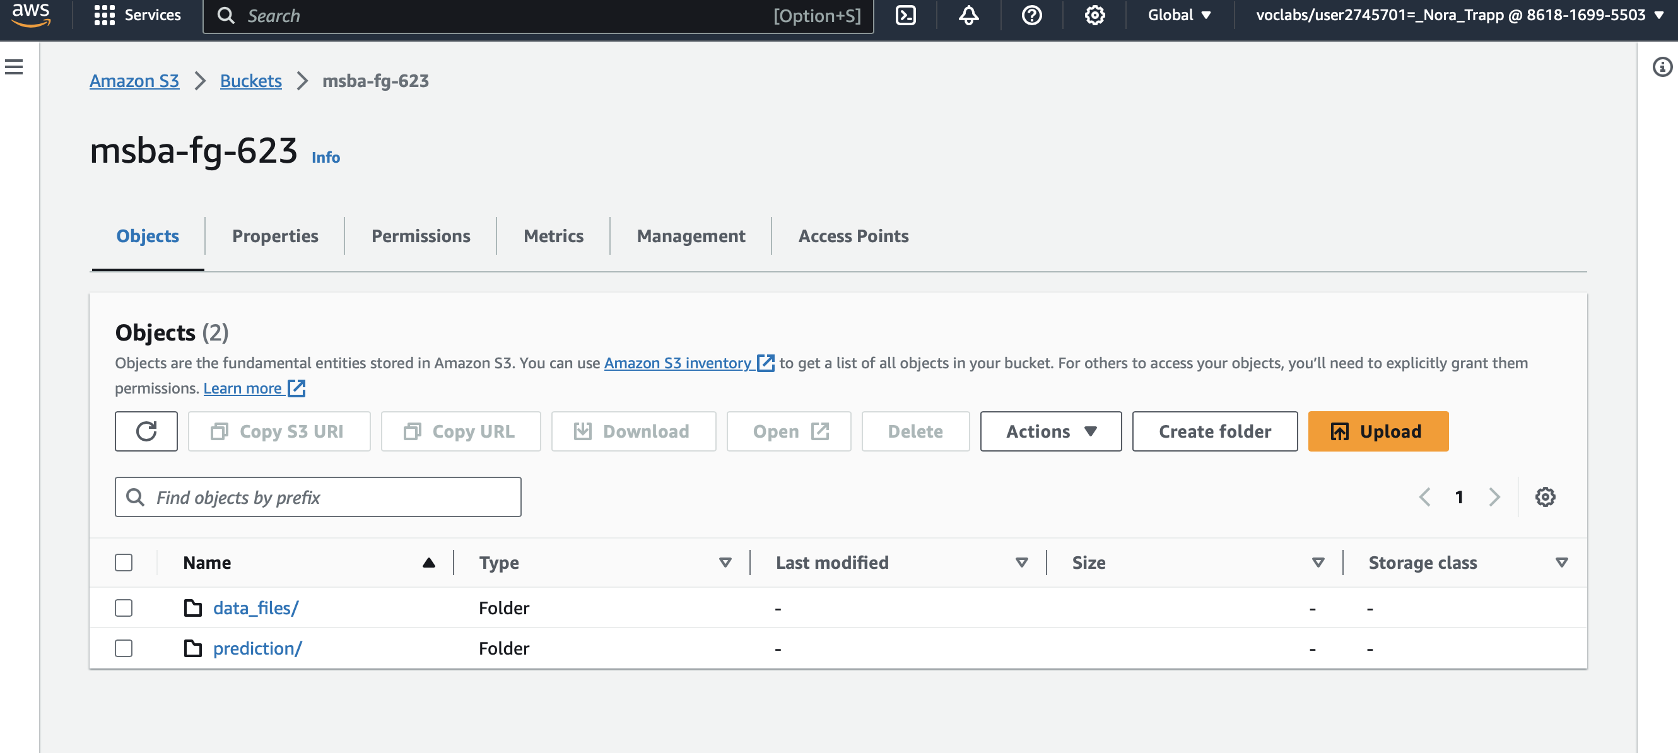
Data Lake in S3: Create Bucket

Slide 4
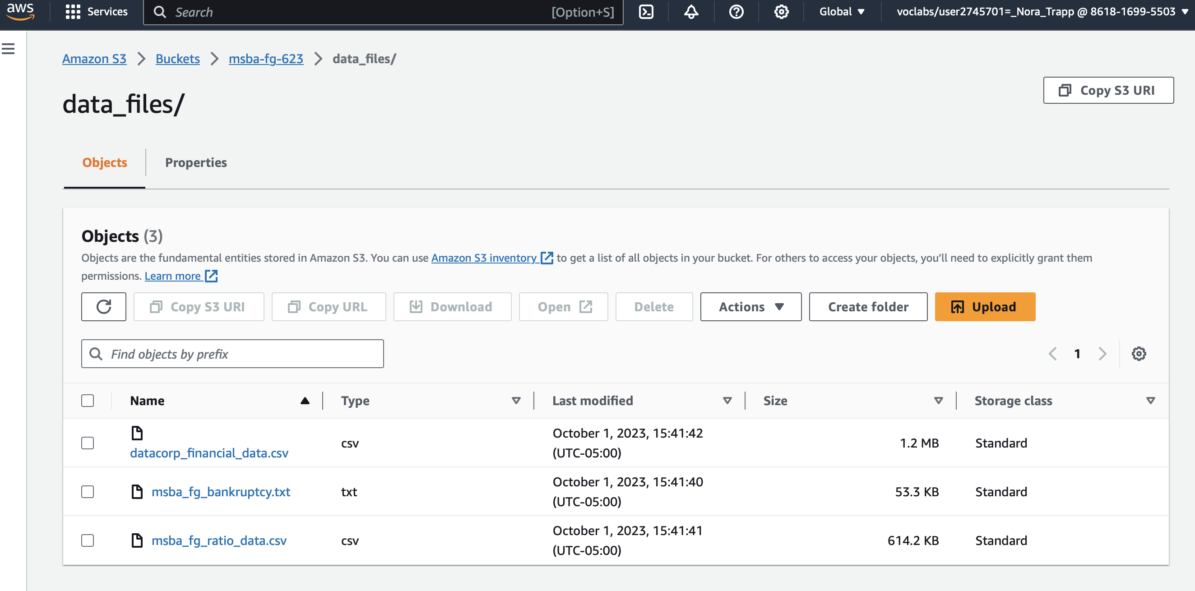
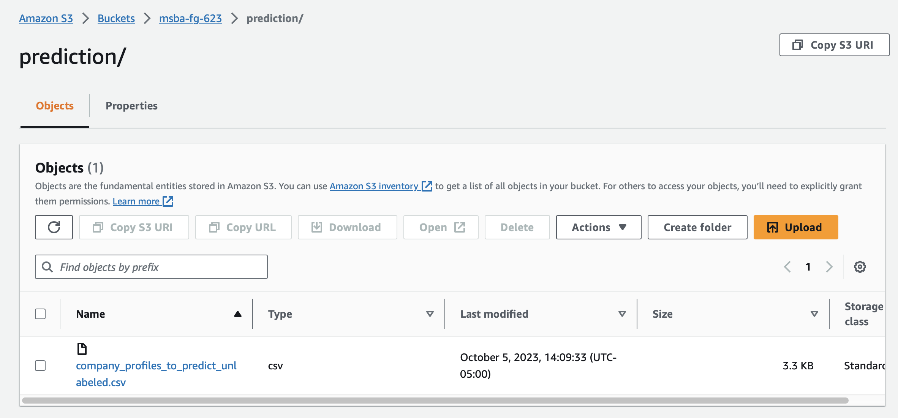
Data Lake in S3: Create Folders Within the Bucket and Upload Sources

Slide 5
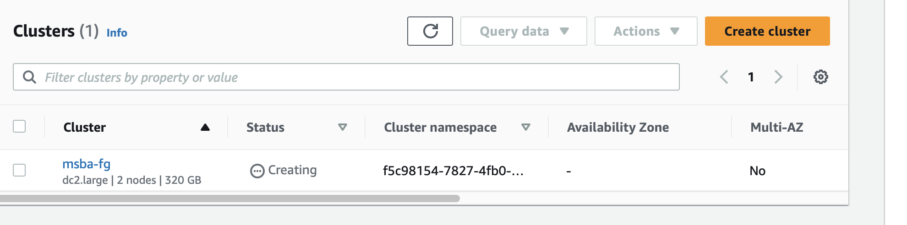
Create a Datawarehouse in Redshift: Create Cluster

Slide 6
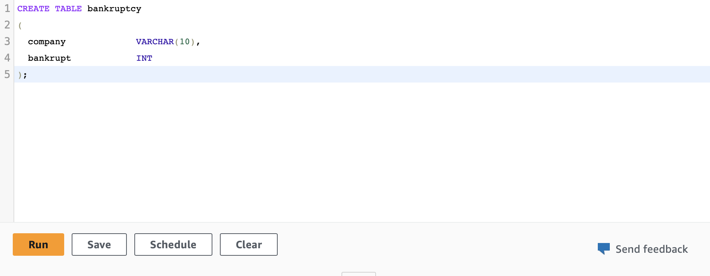
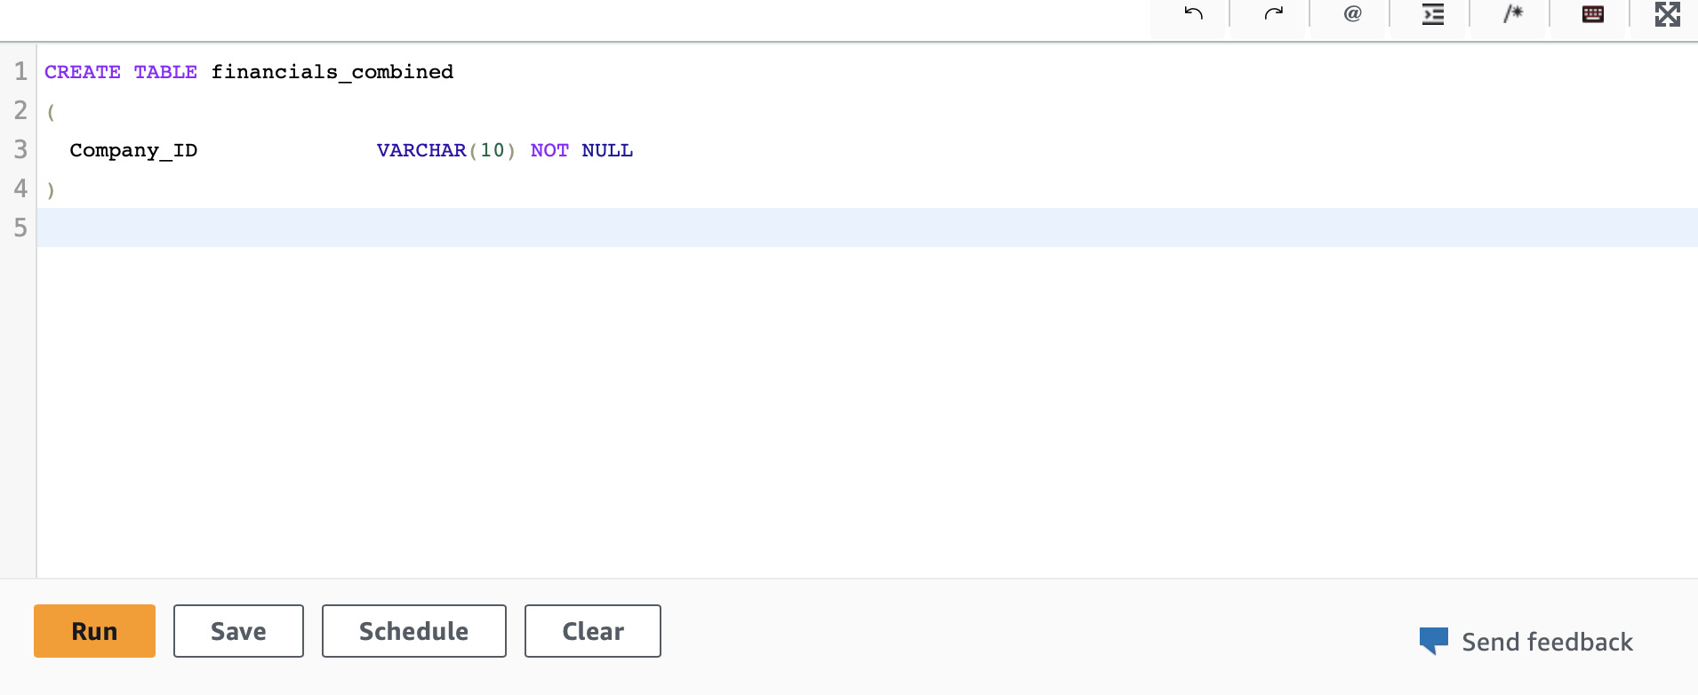
Create a Datawarehouse in Redshift: Create 2 Data Tables
Bankruptcy Table:
- Contains bankruptcy data source
Financials Combined Table:
- Contains both ratio and financial data sources

Slide 7
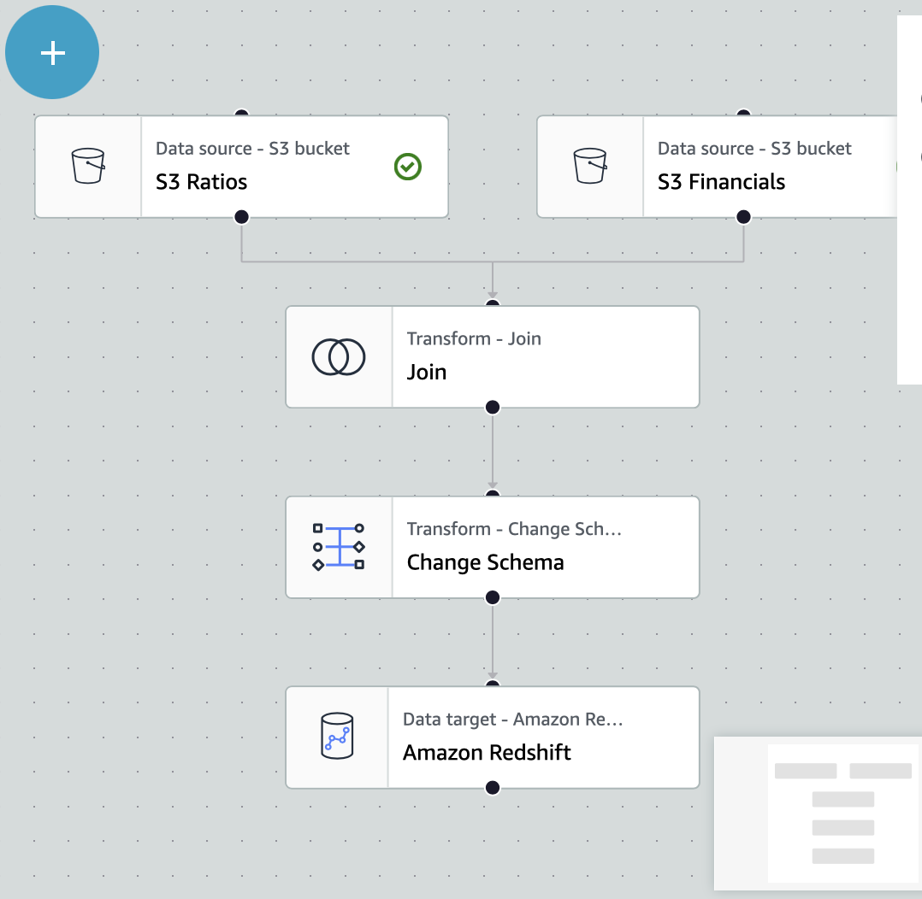
ETL: Fill the Financials Combined Table with Data

Slide 8
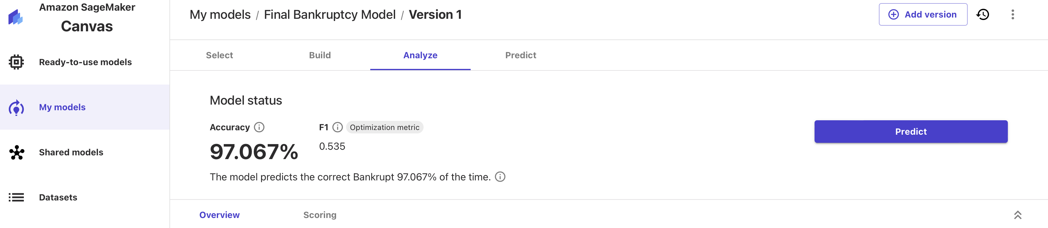
Machine Learning in Sagemaker: Create Model

Slide 9
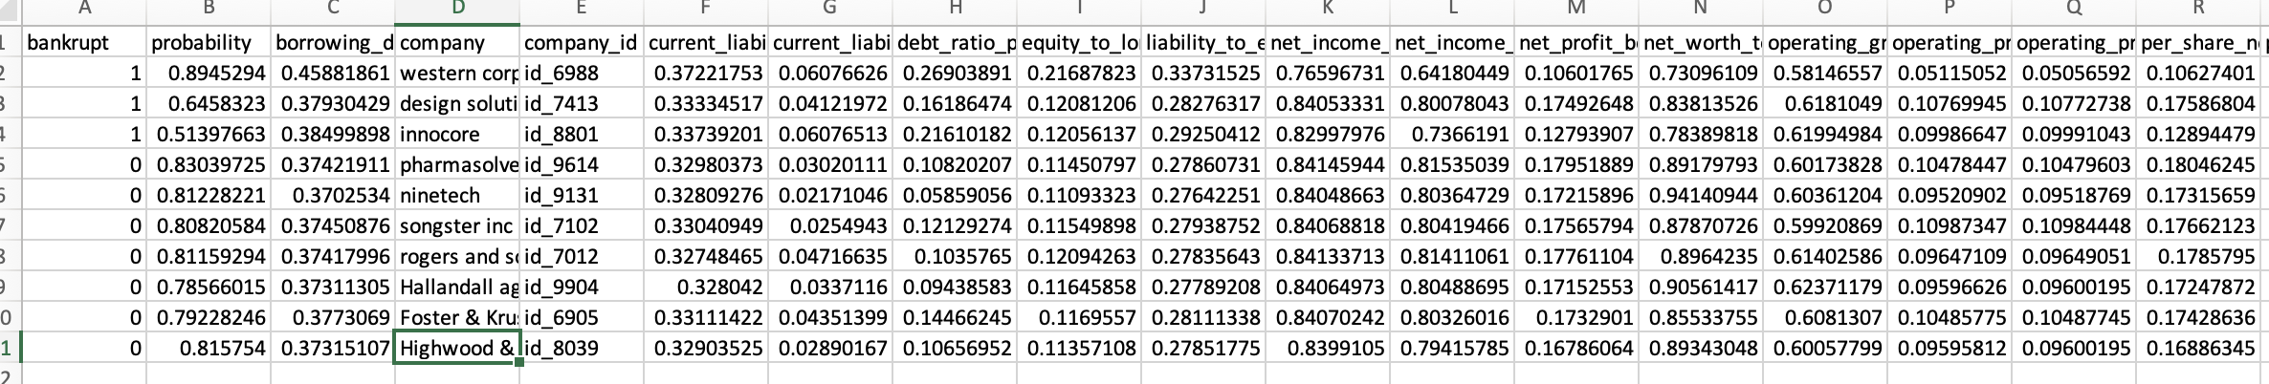
Machine Learning in Sagemaker: Predict with the Model

Slide 10
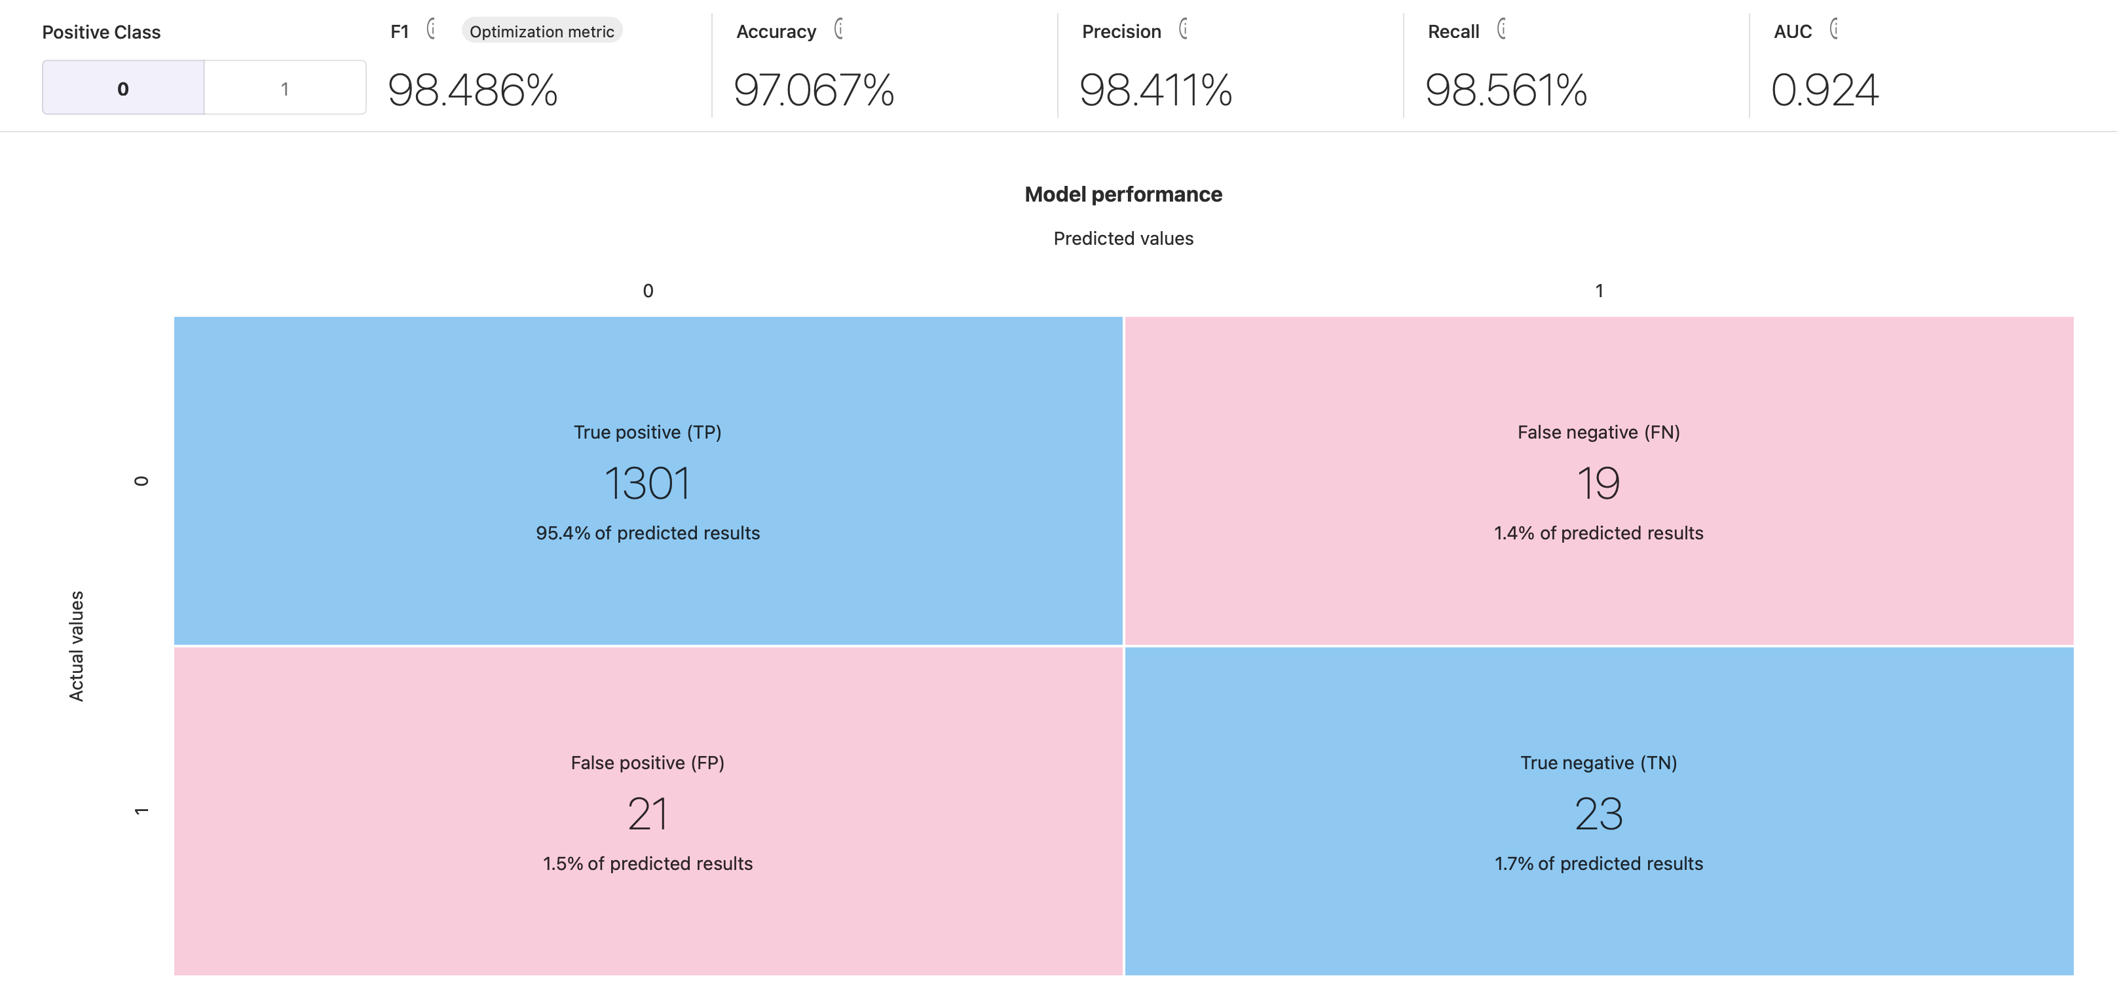
First EDA Finding

Slide 11
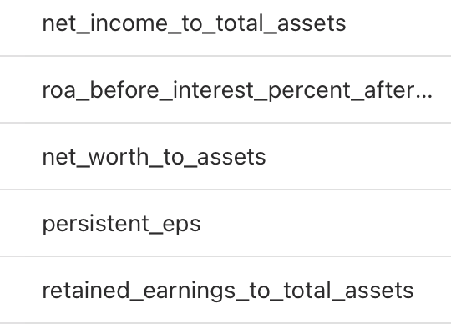
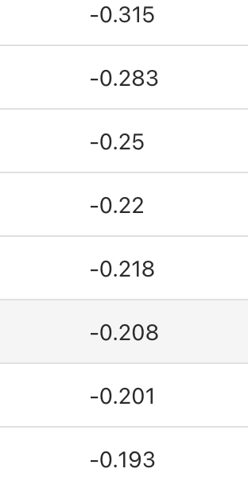
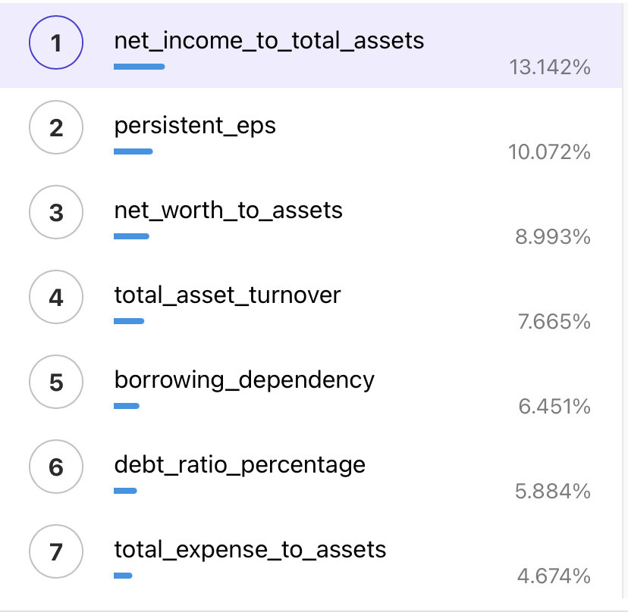


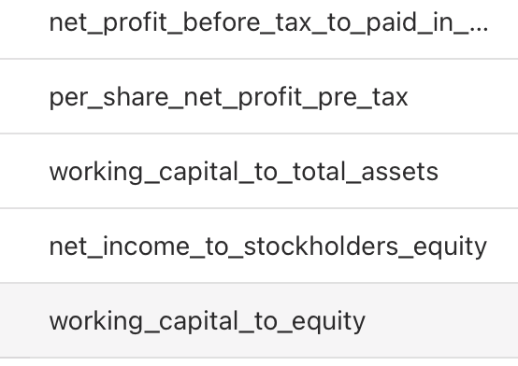
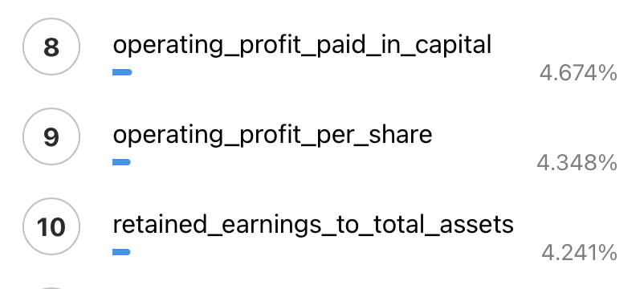
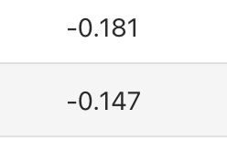

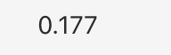
Second EDA Finding
Column Impact for Top 10 (Out of 24 Total) Variables:
Correlation for Top 10 (Out of 24 Total) Variables:

Slide 12
Final Recommendation Based on ML Model
MSBA Financial Group should keep the following companies in their portfolio:
Pharmasolve
Ninetech
Songtser Inc,
Roger and Sons,
Hallandall Ag,
Foster and Kruse
Highwood & Hart.
MSBA Financial Group should not keep the following companies in their portfolio:
Western Corp
Design Solutions
Innocore

